Slide 1
Education Funding in 2012
Rep. Ross Hunter
Chair, Ways and Means Committee
November 2, 2012

Slide 2
Where are we now?

Slide 3
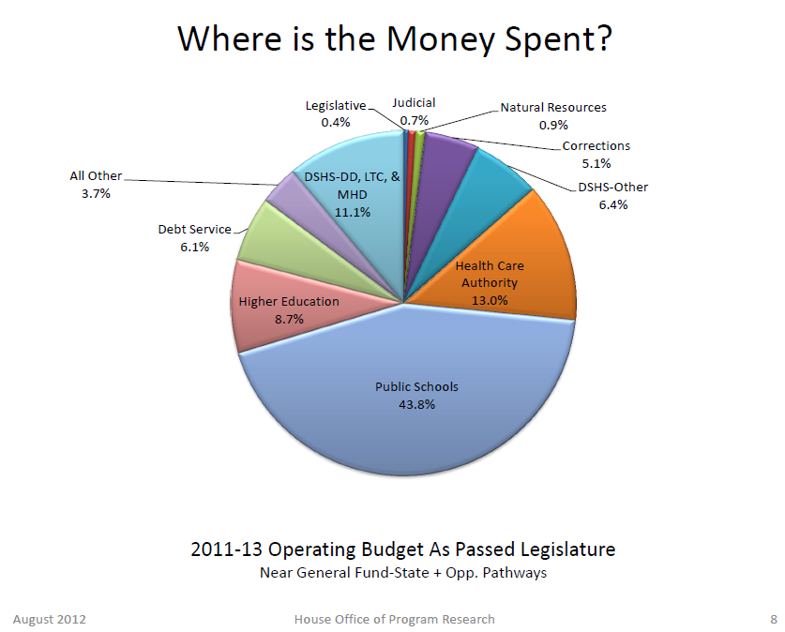
Notes:
K-12 for 1 million students
Higher education for 232,000 students
Healthcare for more than 1,200,000 children and low-income adults
Public Safety including prison for 18,000 inmates and community supervision for 15,000 more

Slide 4
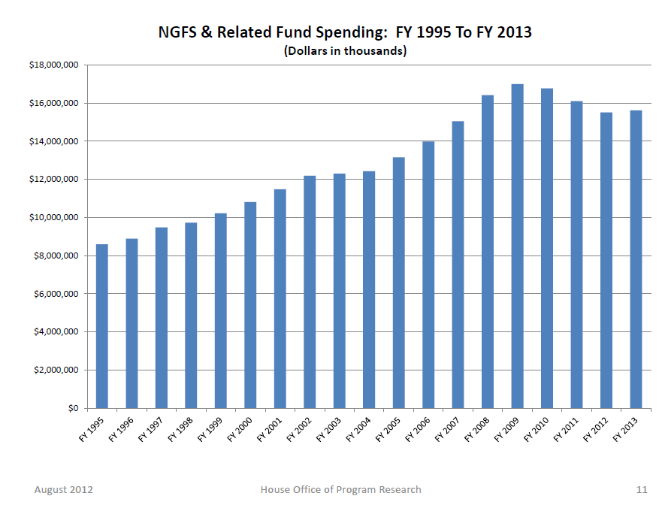

Slide 5
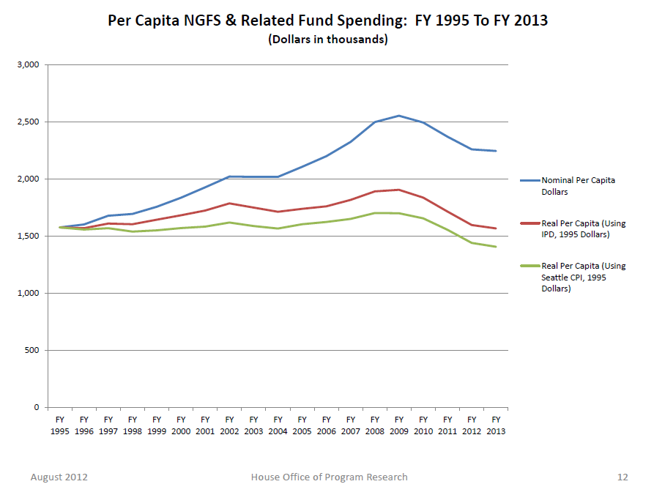

Slide 6
McCleary Decision
Current Legal Requirements
State funding of “basic ed” currently expenses paid for with local levies
New educational programs (all-day Kindergarten, lower K-3 class size)
1080 hour required learning time in middle and high schools instead of 1000, 24 credits
Shift compensation paid with local levies to the state – requires regional comp model
The first two (widely discussed) items cost $1 billion in 2013-15 and grow to $3.3 billion in 2017-19.

Slide 7
Teacher Compensation
More complex than administrative or classified
Regional differences are greater
State salary schedule and bargaining constraints
Base (state-provided) compensation inadequate in most metropolitan areas
Total compensation (including local TRI pay) comparable in all areas

Slide 8
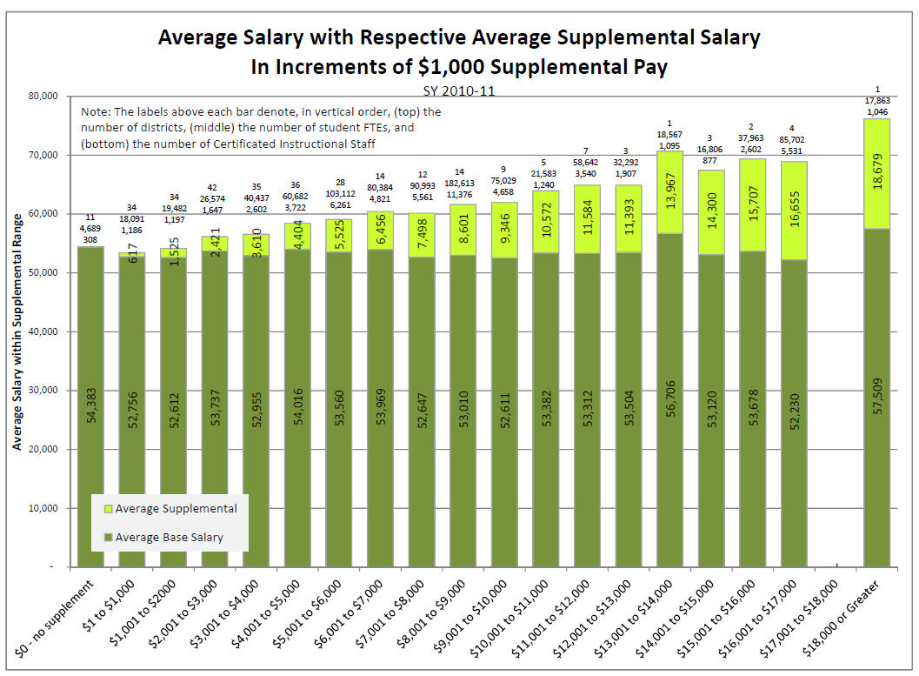

Slide 9
Teacher Compensation (cont.)
Options
Increase state-provided pay across the board to match most expensive area. (costly)
Create a regional pay difference model and pay teachers more in metropolitan areas. (politically painful, operationally difficult)
Allow local compensation to pay regional differences, eliminate TRI euphemism and call it “regional pay differences” or something rational and limit it in reasonable ways.
This financial summary below assumes option #3.

Slide 11
New Problem Statement

Slide 12
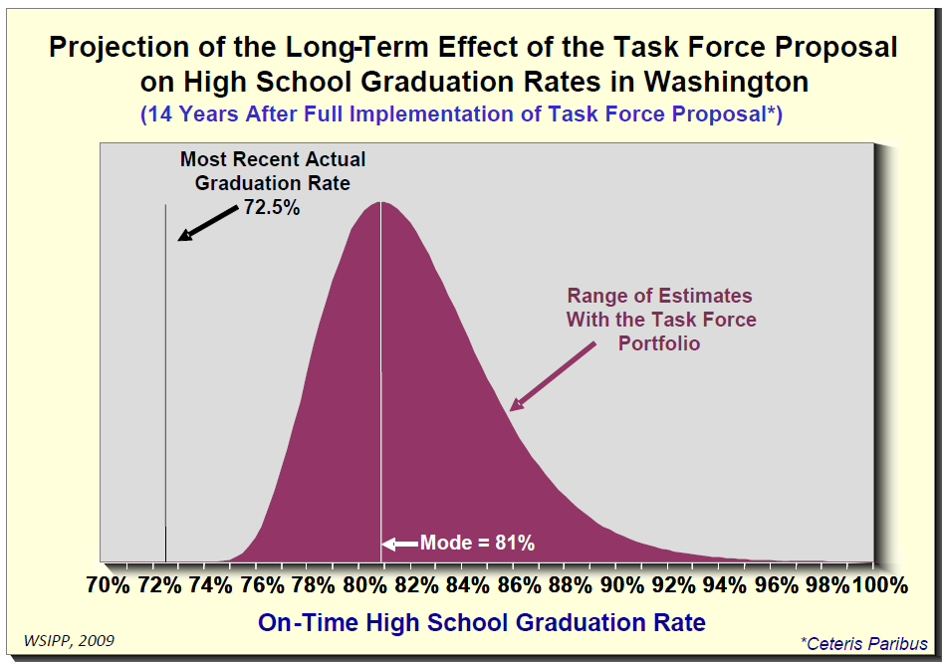
Don’t Be Confused: Funding Matters

Slide 13
How To Pay for It?
“Levy Swap” to solve part of the problem – the part districts are already paying for with local money
Combination of long-term cost reduction strategies and new revenue to pay for the rest

Slide 14
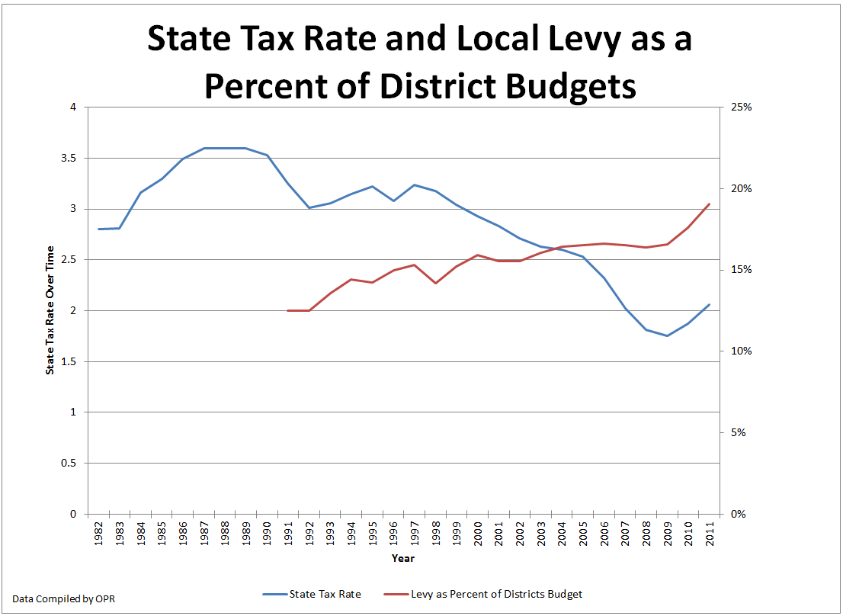
Increasing Levies
Rising local levies are almost back to the late seventies, the levels that prompted the original school funding suits

Slide 15
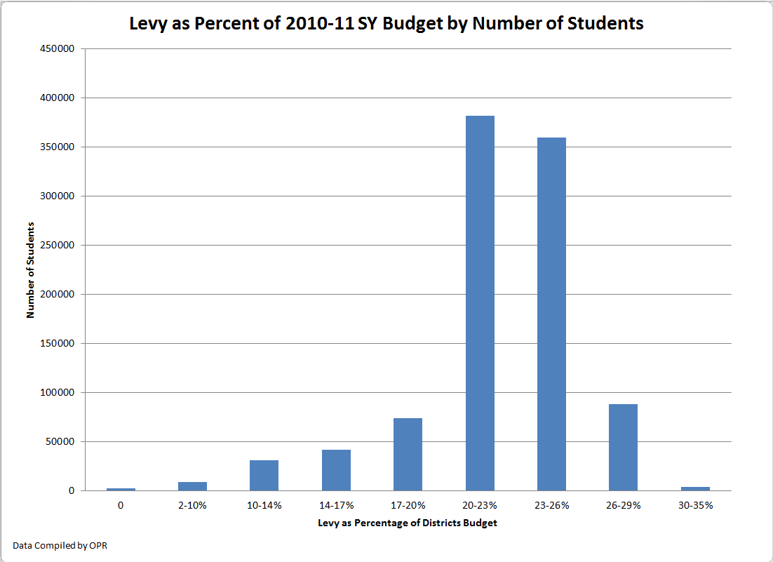
Increasing Budget Risk

Slide 16
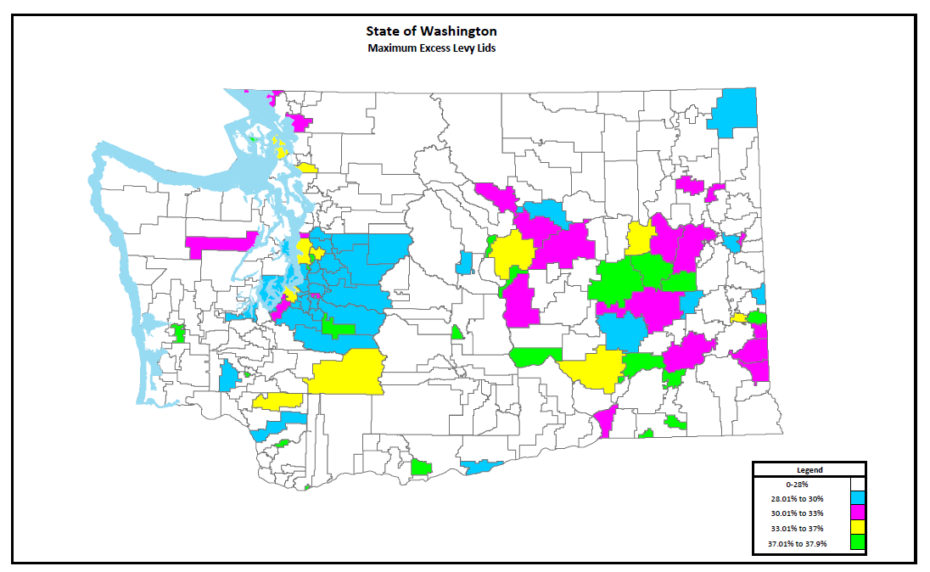
Increasing Inequity
Levy capacity varies widely between districts, often for arbitrary reasons.

Slide 17
Just Fix It
New system should be
Fair.
Basic ed funded by state, not locals.
Larger % of taxes collected statewide, not locally
Adequate.
Meet basic ed responsibility.
If not today, then ensure a growth path that does.
Reliable and Stable
More money “protected” as basic ed.
Levies not subject to elections every 4 years

Slide 18
Proposal: Local Levy Swap
Revenue-Neutral swap of local levies for common school levy
Use basic ed distribution model to drive out new money
Allow growth greater than 1% of the common school levy as we recover from the recession
Reset levy caps at $X ( $X >= $2500) per student
Make levies reliable by making them permanent

Slide 19
Why?
Common School Levy works better than LEA
More money is “basic education” and hence constitutionally protected
Growth starts to pay for constitutional requirement of ample funding
Eliminates all grandfathering, a huge problem in Puget Sound districts

Slide 20
This Proposal Does NOT
Put NEW money into most school districts.
It changes from unreliable local levies to reliable and fairer state collection.
Some districts will get a little more money.
Increase Aggregate State Taxes
Afterwards local districts will have additional levy capacity and could ask their voters for increases, but the total share of local levies would still be smaller.

Slide 21
Long-Term Growth

Slide 22
Examples
See related spreadsheet: http://www.rosshunter.info/wp-content/uploads/2012/10/Example-Levy-Swap.xlsx

Slide 23
Issues
Levy Equalization. The overall levy base is reduced in this proposal, which would change LEA. Practically, the LEA formula needs to be re-written so it grows at the same rate that collected levies do, not at twice the rate.
Final levy capacity. Seattle legislators have expressed concern that their district pays $111 million per year in new taxes and gets no additional school funding – we may need a higher levy cap to resolve this.
Revenue and/or cuts for the rest. This will be complex and interesting.

Slide 24
Questions?
Rep. Ross Hunter www.rosshunter.info
Bellevue Office (425) 453-3064
Olympia Office (360) 786-7936 January to April
ross.hunter@leg.wa.gov

